Slide 1
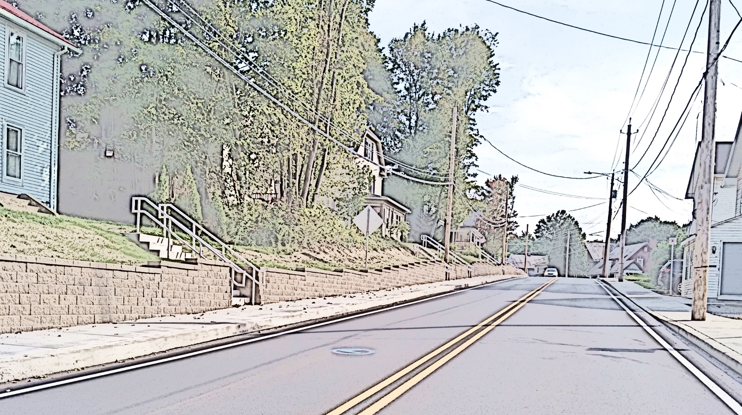

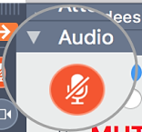

Coordinating Committee Meeting
Tuesday, September 9, 2025—10:30am
This meeting will be recorded.
Please mute your mic unless you are speaking. Thank you!
Click the microphone logo to mute; and click again to un-mute.
Once muted, microphone logo will be red and look like this →

Slide 2
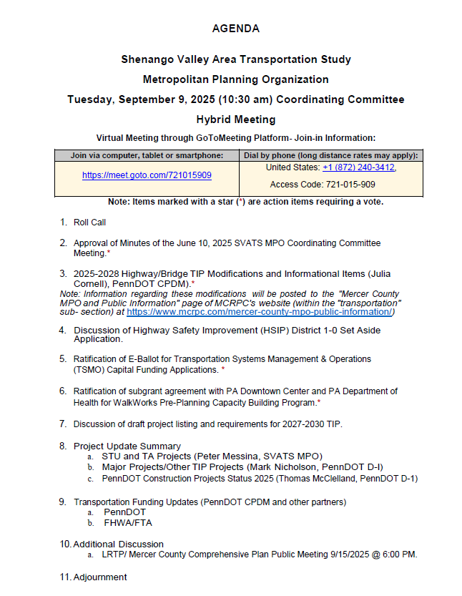

Slide 3
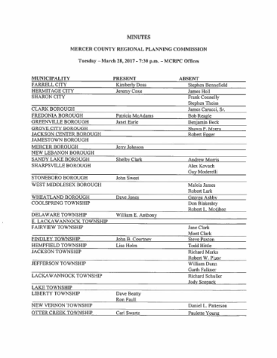
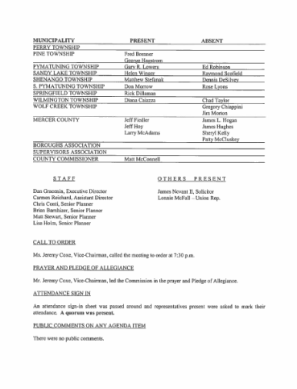
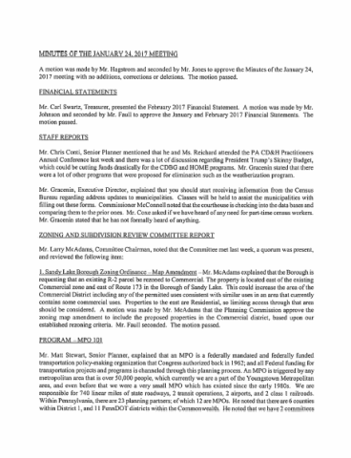
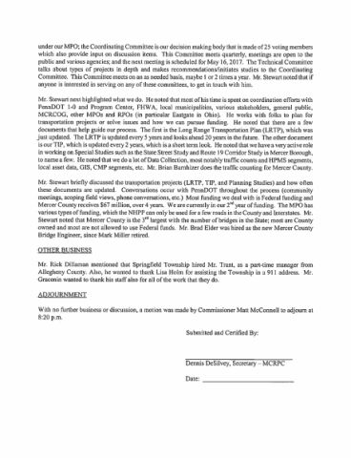
Minutes of the 6/10/2025 Meeting*
Motion Needed to Approve

Slide 4

2025-2028 Highway/Bridge TIP Modifications and Informational Items
Tip Modifications*
  Motion Needed to Approve
Informational Items
HSIP Applications

Slide 5



Discussion and Ratification of PA WalkWorks Subgrant Agreement*
Completed E-Ballot to pass motion to enter subgrant agreement for the for WalkWorks Pre-Planning Capacity Building Program.
  Received 15 “Yes” Votes and 0 “No” Votes.
Submitted Application on 5/22/2025.
Active Transportation Workshop in Mercer County
Motion to Ratify.

Slide 6
Discussion and Ratification of TSMO Application*
Passed E-Ballot with 15 “Yes” Votes and 0 “No” Votes.
Type A message board(s) would be located at the approaches to Interstate 80 from SR 18 and have a two-fold benefit - it can be used for real-time traffic messages/alerts and is critical for emergency situations.
3 full-size Digital Message Boards (DMS) to better support our detouring abilities. The full-size board on I-80 will be placed prior to Exit 24, giving eastbound traffic the ability to exit if needed. In a previous round we requested and were granted a westbound board in this area that is currently under construction.
2 CCTV (Closed Circuit Television) cameras at the I-79 / SR 358 interchange and in the area of the I-80 / SR 173 interchange. This is useful for identifying and assessing incidents, as well as a visual for weather coming into the Mercer area.

Slide 7
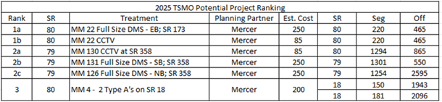
Discussion and Ratification of TSMO Application*
For all three projects, we would be looking at a total approximate cost of $1,475,500. At a 20% match, we would be asking for $295,100 from SVATS MPO.

Slide 8
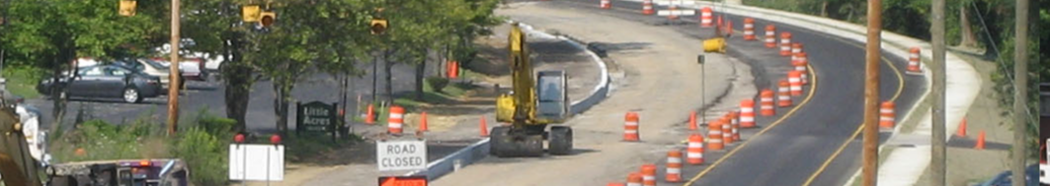
Project Update Summary
STU and TA Projects (SVATS MPO Staff)
Major Projects/Other TIP Projects (Mark Nicholson, PennDOT D-1)
PennDOT Construction Projects Status 2024 (Tom McClelland, PennDOT D-1)

Slide 9

Transportation Funding Updates
PennDOT
  2027-2030 TIP Guidance
FHWA/FTA

Slide 10
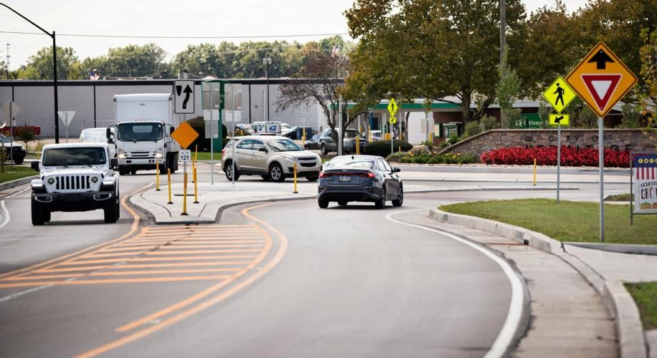
Additional Discussion

