Slide 1
Coordinating Committee Meeting
Tuesday, June 10, 2025—10:30am
This meeting will be recorded.
Please mute your mic unless you are speaking. Thank you!
Click the microphone logo to mute; and click again to un-mute.
Once muted, microphone logo will be red and look like this →

Slide 2
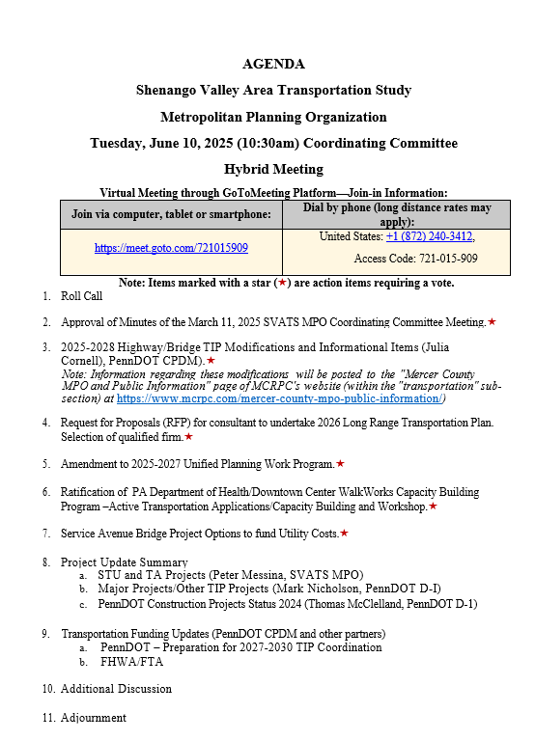

Slide 3
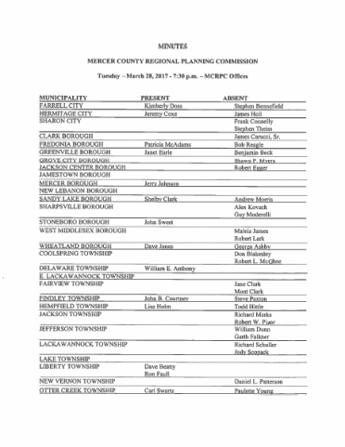
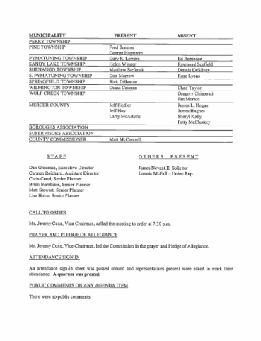
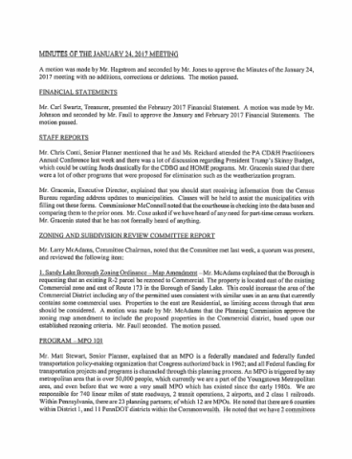
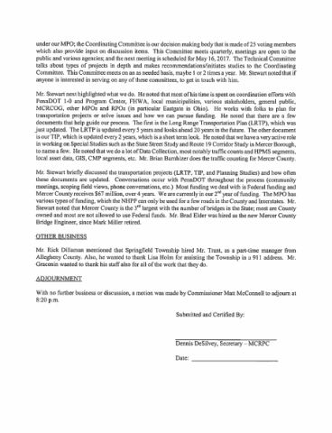
Minutes of the 3/11/2025 Meeting*
Motion Needed to Approve

Slide 4
2025-2028 Highway/Bridge TIP Modifications and Informational Items
Tip Modifications*
Motion Needed to Approve
Informational Items

Slide 5
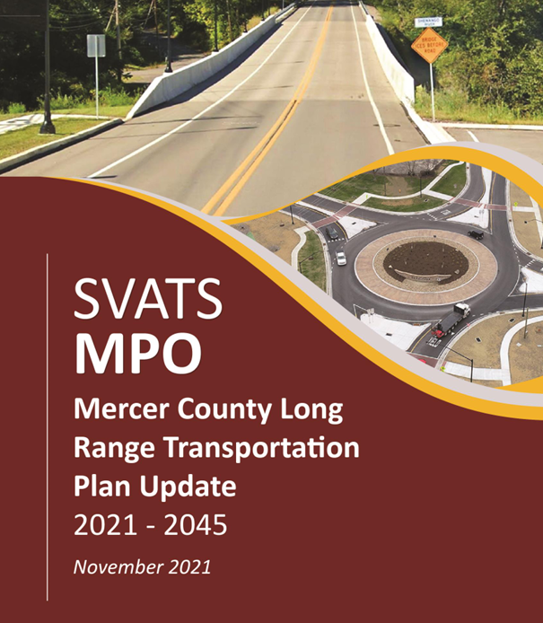
Discussion & Approval of 2026 LRTP Consultant*
Received Two Responses to RFP
AECOM
The Steering Committee Recommends Awarding Contract to AECOM.
Proposal Highlights
5 Steering Committee Meetings
4 Public Meetings (2 In-Person & 2 Virtual)
Up to 6 Stakeholder Interviews
Option for Half-Day In-Person Stakeholder Workshop

Slide 6
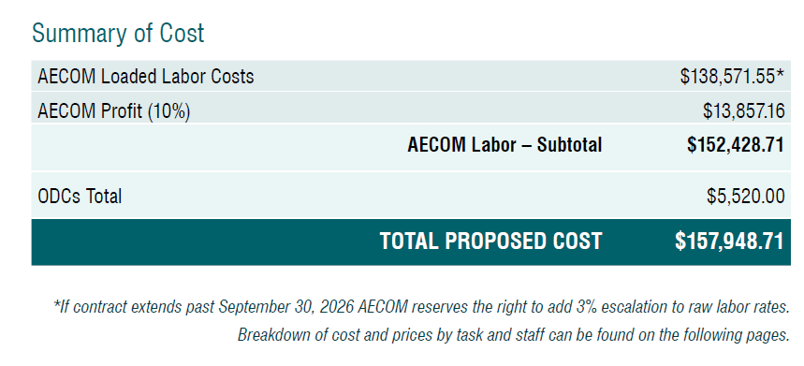
Discussion & Approval of 2026 LRTP Consultant*
Motion Needed to Approve

Slide 7
Revisions to 2025-2027 UPWP

Slide 8
Revisions to 2025-2027 UPWP

Slide 9
Revisions to 2025-2027 UPWP

Slide 10
Discussion and Ratification of of PA WalkWorks Program*
Completed E-Ballot to pass motion to apply for the for WalkWorks Pre-Planning Capacity Building Program.
Received 11 “Yes” Votes and 0 “No” Votes.
Submitted Application on 5/22/2025.
Active Transportation Workshop in Mercer County
Motion to Ratify.

Slide 11
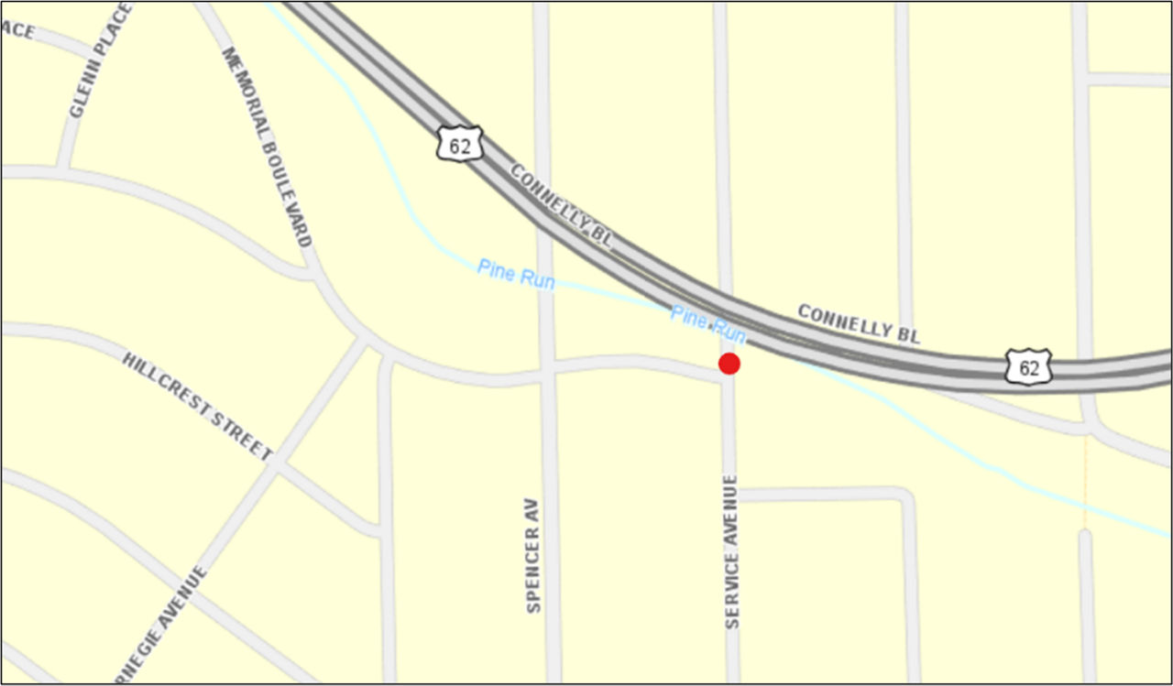
Service Avenue Bridge Project
Project replaces the bridge that carries Service Avenue over Pine Run in the City of Sharon
The existing concrete bridge was built in 1951.
Classified as poor condition and is posted with a 13-ton weight limit.
Approximately 1,650 vehicles a day use the bridge, on average.
Requires $200,000 to $300,000 of additional funding to cover Utility Costs.
Discussion and Motion to decide how to proceed.*

Slide 12
Project Update Summary
STU and TA Projects (SVATS MPO Staff)
Major Projects/Other TIP Projects (Mark Nicholson, PennDOT D-1)
PennDOT Construction Projects Status 2024 (Tom McClelland, PennDOT D-1)

Slide 13
Transportation Funding Updates
PennDOT
2027-2030 TIP Guidance
FHWA/FTA

Slide 14
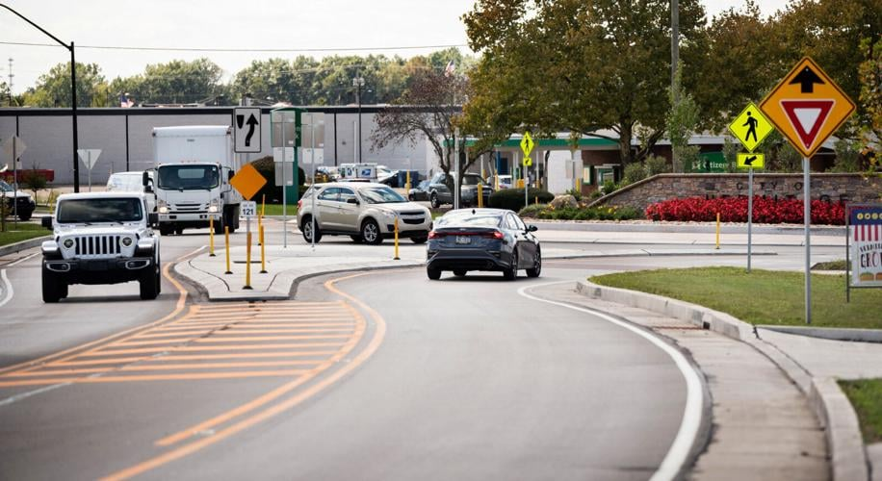
Additional Discussion

