Slide 1
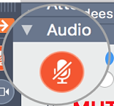
Mercer County Regional Planning commission meeting
Please mute your mic unless you are speaking. Thank you!
Click the microphone logo to mute; and click again to un-mute. Once muted, microphone logo will be red and look like this →
If you’re using the Telephone option, you need to enter your Audio PIN before you can use the Control Panel to mute yourself. Or, you can press *6 on your telephone keypad.
7:00 p.m. April 22, 2025

Slide 2

Prayer & Pledge of Allegiance

Slide 3
*Roll call- please state your name
*Public Comments

Slide 4
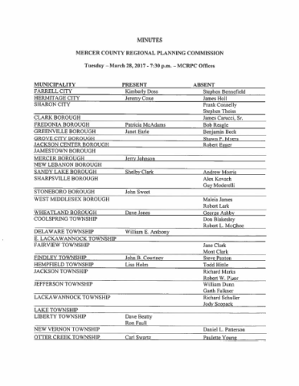
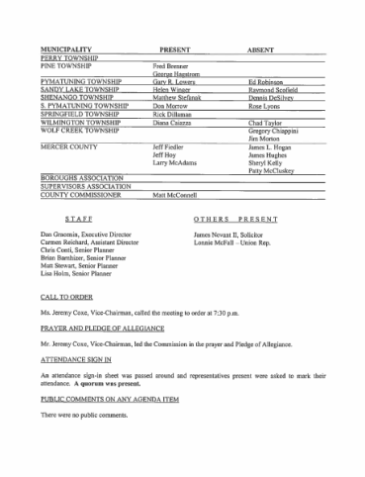
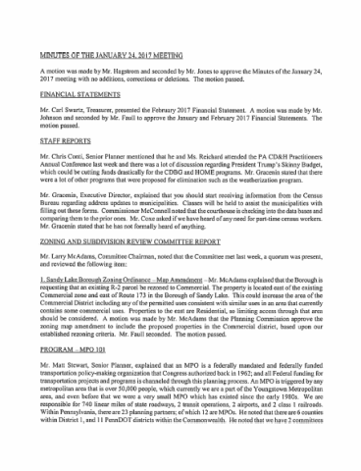
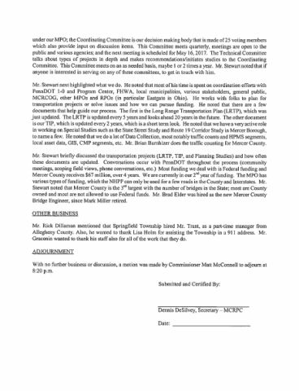
Minutes of the 3/25/2025 Meeting
Motion needed to approve

Slide 5
March 2025 Financial Statement
 | Cash Account | Cash-Sweep Account
March beginning balance | $26,513.27 | $198,698.69
March receipts | $22,828.61
March cash disbursements | $24,043.75
March Other (payroll and interest in cash account) | $8,818.72 | $35,735.60
March ending balance | $34,116.85 | $162,963.60

Slide 6
Zoning & Subdivision Committee
Clark Borough has not submitted text amendments no changes at this time.
SALDO Update- group met and has some additional thoughts a working session is scheduled for Monday, April 28 at 5:00pm

Slide 7
Personnel Finance Committee
Right to Know Policy: Action
Social Media Policy: Action
Sunshine Act Policy: Action
Update on Personnel Manual

Slide 8
Action Item
Amend the CDBG Administrative Agreement with Greenville to include the Administration of HOME funds.

Slide 9

Staff Reports
Mercer County Main Street Matters Grant for Affordable Housing was awarded.
CDBG Environmental Reviews Underway
Community Flier
RFP for Long Range Plan open due May 12
Continue to field calls from Members on project requests!
County Comprehensive Plan
Please know our staff is here to assist!

Slide 10
Support letters for the following projects sent
  DCNR- City of Sharon and Mercer County Conservation District
  Buhl Community Water Project GIS Mapping
  City of Sharon- Catch Basin rehabilitation
  Fredonia Borough Rehabilitation of sanitary lines
  Grove City Borough- East Main Street waterline
  Jamestown Municipal Authority- water plan improvements
  Neshannock Creek Watershed Joint Municipal Authority-Sewer Extension
  Sharon Sanitary Authority- Service Bridge line relocation
  Springfield Township-waterline extension

Slide 11
Schedule
Zoning and Subdivision Committee will have a working session April 28, 2025 5:00PM
Plans and Amendment submission deadline May 9.
Zoning and Subdivision Committee meeting will be May 20 7:30 PM
Finance and Personnel will meet May 27 6:00 PM
Full Commission meeting before summer break May 27 at 7:00 PM
  Guest Speaker Buddy Miller PennDOT Municipal Services

Slide 12
Discussion
DCED will present on Implementable Comp Plans
    Katie Wickert | Local Government Planning Specialist
    PA Department of Community & Economic Development
    Office of Community Planning
    Governor’s Center for Local Government Services
    Northwest Regional Office
    100 State Street, Suite 205 | Erie, PA 16507
    Phone: 717-433-8587 | kwickert@pa.gov
Mackin Engineering will present Mercer County Comp Plan Update
  BRANDI ROSSELLI AICP
  Director of Community Planning
  103 Technology Drive | Suite 200 | Pittsburgh, PA 15275
  412.417.8712 brosselli@mackinengineering.com

Slide 13
Homework/Activity
Please send or bring with you-
  Your Vision Statement for Mercer County- for our community in 10 years.
  Your thoughts on sticky notes or notecard: ​
    Roots: Community strengths. ​
    Trunk: Current initiatives or programs supporting the community. ​
    Branches: Potential strategies or actions to achieve future goals. ​
    Leaves: Desired outcomes or achievements. ​
    Cloud: The overarching vision or dream for the community’s future. ​

Slide 14
Adjournment

